Slide 1

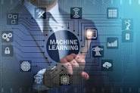

RAJA BALWANT SINGH ENGINEERING TECHNICAL CAMPUS
PROJECT PRESENTATION
ON
SMART COLLEGE SYSTEM SOFTWARE PRESENTED BY :-
ABHINAV VERMA (2000040100003)
ADITYA KUMAR SINGH (2000040100010)

Slide 2
CONTENTS
Introduction
Objectives
What is Smart College System Software ?
Problem Statement
Solution
Previous Technologies Used
System Requirements
Tools & Technologies
Data Flow Diagram
Output of the Project
Conclusion

Slide 3
INTRODUCTION
In the era of digital transformation, educational institutions are embracing advanced technologies to enhance efficiency, improve learning experiences, and streamline administrative processes. The integration of Python, Data science, and Machine learning techniques to a Smart College System Software represents a groundbreaking approach towards achieving these goals.

Slide 4
OBJECTIVES
The aim is to develop a Smart College System Software that addresses these challenges and provides the following key features :
Automation & Efficiency
Comprehensive Data Management
Enhanced Communications
Advanced Analytics and Reporting

Slide 5
WHAT IS SMART COLLEGE SYSTEM SOFTWARE ?
The term could refer to a software system designed to enhance various aspects of college system and operations through smart technologies. Here smart means smart work done in a short time and send through E-Mail.
In general, a smart college system software might includes features such as :
STUDENT SUPERVISION
FACULTY INFORMATION
LIBERARY INFORMATION
ATTENDANCE SYSTEM
QUIZ PORTAL
DATA ANALYTICS

Slide 6
PROBLEM STATEMENT
The existing college system software lack integration, user-friendliness, and advanced features required to meet the evolving needs of modern educational institutions. These systems often suffer from the following issues :
Transparency Admission :
Kota admission through teachers.
Data Management Challenges :
Disorganized student & staff data management.
Limited or no integration with external databases & platforms.
Inefficiency in Administrative Tasks :
Tedious & time-consuming manual administrative processes.
Lack of automation in tasks such as attendance tracking, resource allocation.
Limited Analytics and Reporting :
Inadequate tools for data analysis & reporting.
Difficulty in tracking student performance, attendance trends, & course effectiveness.

Slide 7
SOLUTION
Automation & Efficiency :
Implement automation for routine administrative tasks like attendance tracking and resource management, reducing manual effort and minimizing errors.
Centralized Data Management :
Establish a centralized database for student and staff information, ensuring data accuracy, easy retrieval, and seamless integration with external platforms.
Enhanced Communication :
Introduce real-time communication channels, announcements, & discussion forums, fostering effective communication between students, faculty, and administration.
Advanced Analytics & Reporting :
Incorporate robust analytics tools to analyze student performance, attendance trends, and course effectiveness, enabling data-driven decision-making. Implement predictive analytics to identify patterns and trends for proactive measures.
Customization & Scalability :
Provide customization options to cater to the specific needs of different educational institutions. Ensure the system is scalable to accommodate growing data and user requirements.

Slide 8
PREVIOUS TECHNOLOGIES USED
Paper-Based Systems :
Before the advent of digital technologies, many colleges relied heavily on paper-based systems for record-keeping, including student registration, grades, and administrative tasks. These systems were labor-intensive and prone to errors.
Terminal-Based Systems :
Colleges used dumb terminals, which were input/output devices with no processing capabilities of their own. These terminals were connected to mainframe computers and allowed users to interact with the college system software through a command-line interface.
Databases :
Early college systems used flat file databases where data was stored in simple text files or binary files. These databases were limited in terms of scalability and querying capabilities compared to modern relational databases.
Fortran ( Formula Translation ) :
Fortran is a general-purpose, imperative programming language that was developed for scientific and engineering calculations. In the early days of computing, Fortran was used for academic research and data processing tasks in colleges and universities.

Slide 9
.
COBOL ( Common Business-Oriented Language ) :
COBOL was one of the earliest high-level programming languages designed for business, finance, and administrative systems. It was widely used in the 1960s and 1970s for developing mainframe-based college administrative applications.

Slide 10
SYSTEM REQUIREMENTS
Hardware Requirements :
8 GB RAM ( min )
SSD ( Solid State Drives ). Ensuring fast data access
Intel i5 or Ryzen 5 processor or similar
Network Connectivity
Software Requirements :
Spyder ( anaconda 3 )
MySQL

Slide 11
TOOLS & TECHNOLOGIES USED
PYTHON
GUI
Python is a computer programming language often used to build websites and software, automate tasks, and analyze data. Python is a general-purpose language, not specialized for any specific problems, and used to create various programmes.
GUI stands for Graphical User Interface, and refers to computer programs that provide a visual means for users to interact with an underlying application or system.

Slide 12
.
CSV file
MySQL
A CSV is a comma-separated values file, which allows data to be saved in a tabular format.
MySQL is a tool used to manage databases and servers, so while it's not a database, it's widely used in relation to managing and organizing data in databases.

Slide 13
.
DATA SCIENCE
SMTP
Data science is the hottest technology of the digital age. Python is one of the most popular languages in data science, which is used to perform data analysis, data manipulation, and data visualization.
SMTP ( Simple Mail Transfer Protocol ) is a TCP/IP protocol used in sending and receiving email. SMTP is used most commonly by email clients, including Gmail, Outlook, Apple Mail & Yahoo Mail. SMTP can send and receive email, but email clients typically use a program with SMTP for sending email.

Slide 14
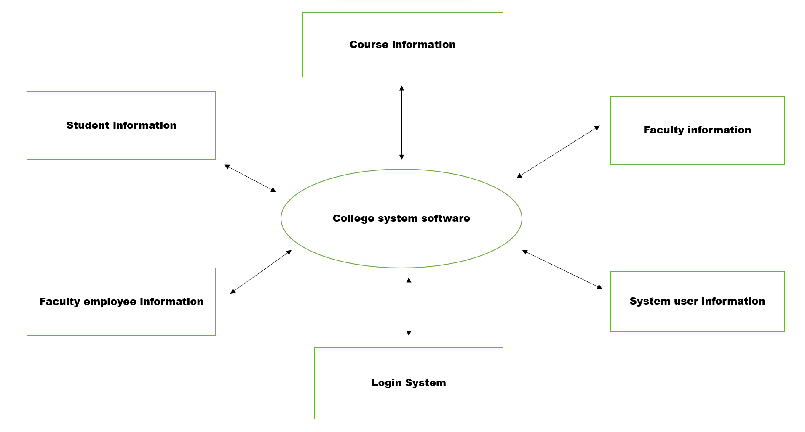
DATA FLOW DIAGRAM 1) Zero level DFD
.

Slide 15
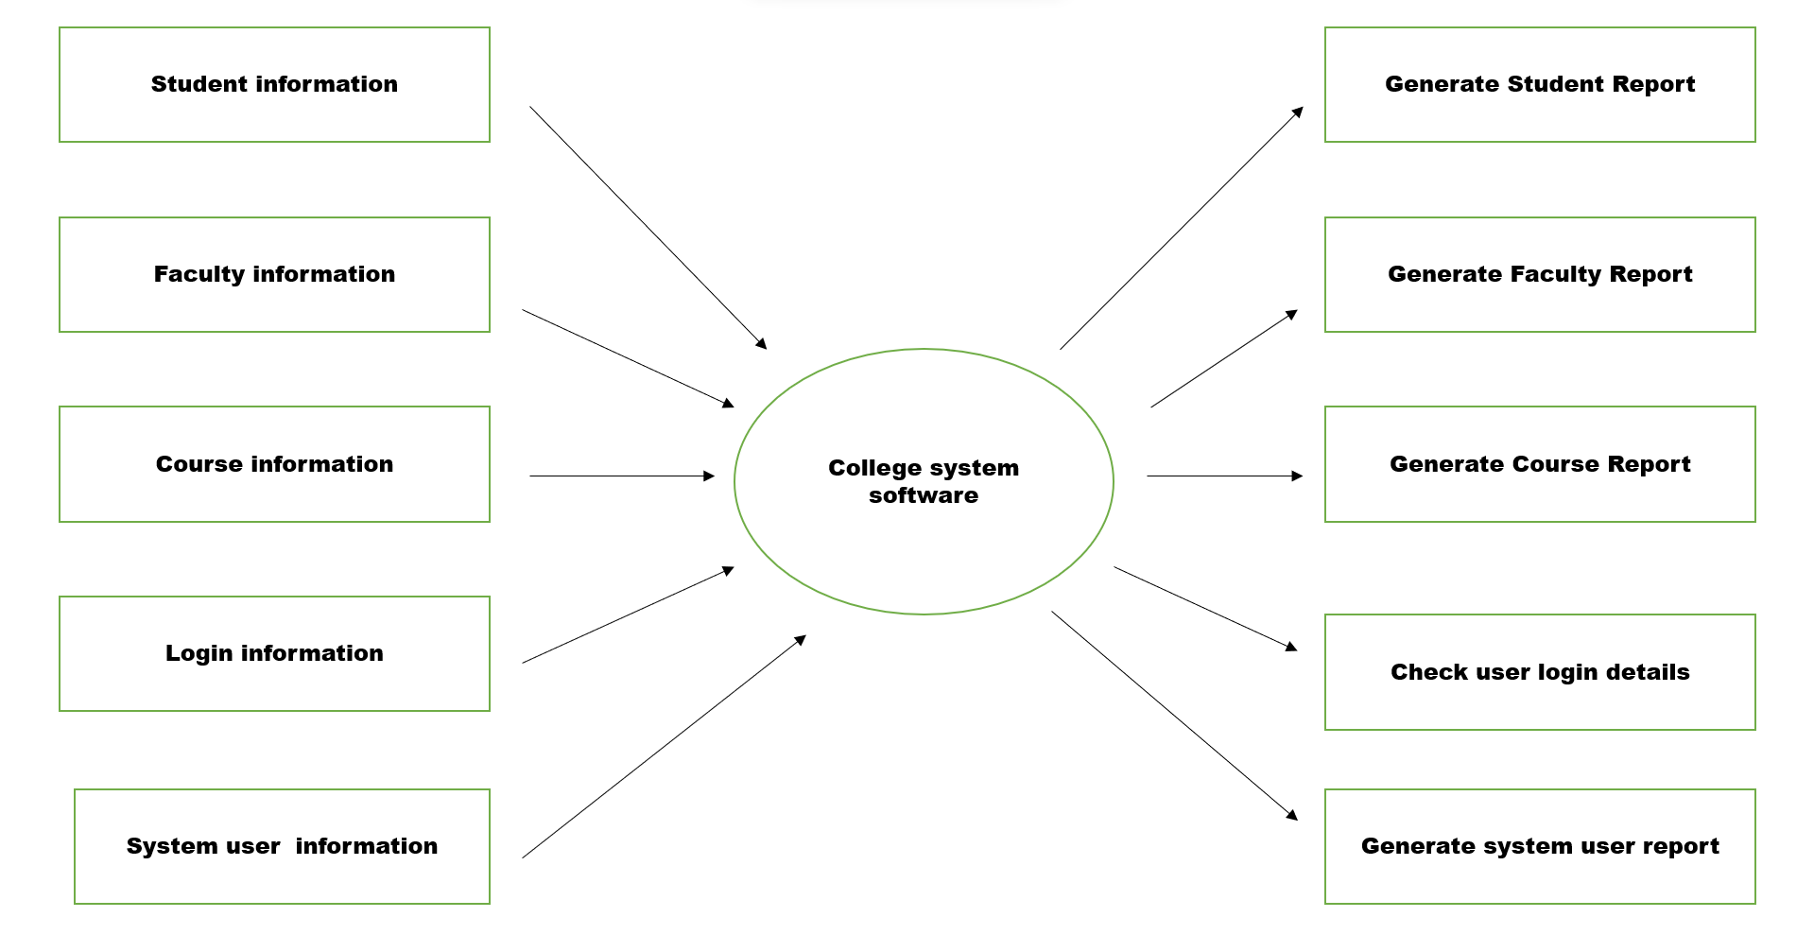
2) First level DFD

Slide 16
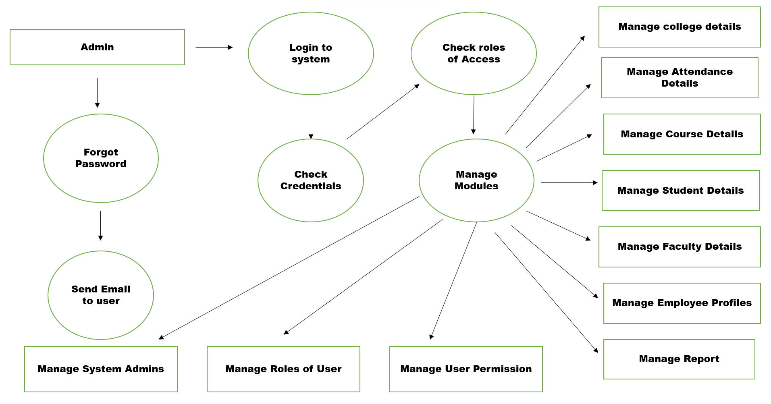
3 ) Second level DFD

Slide 17
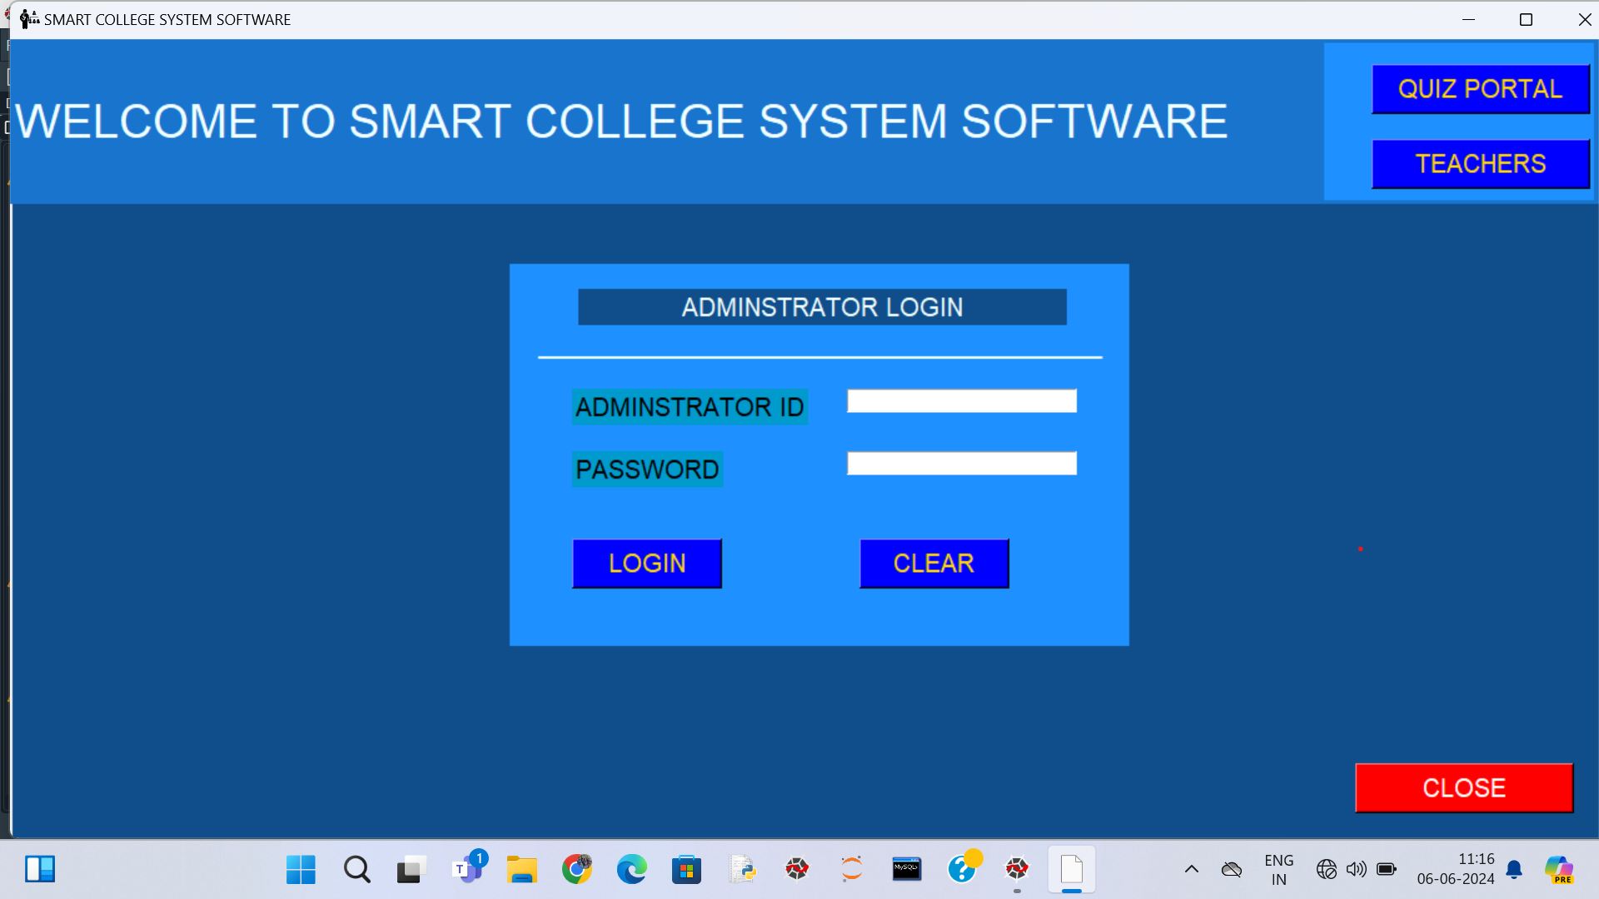
OUTPUT OF THE PROJECT

Slide 18
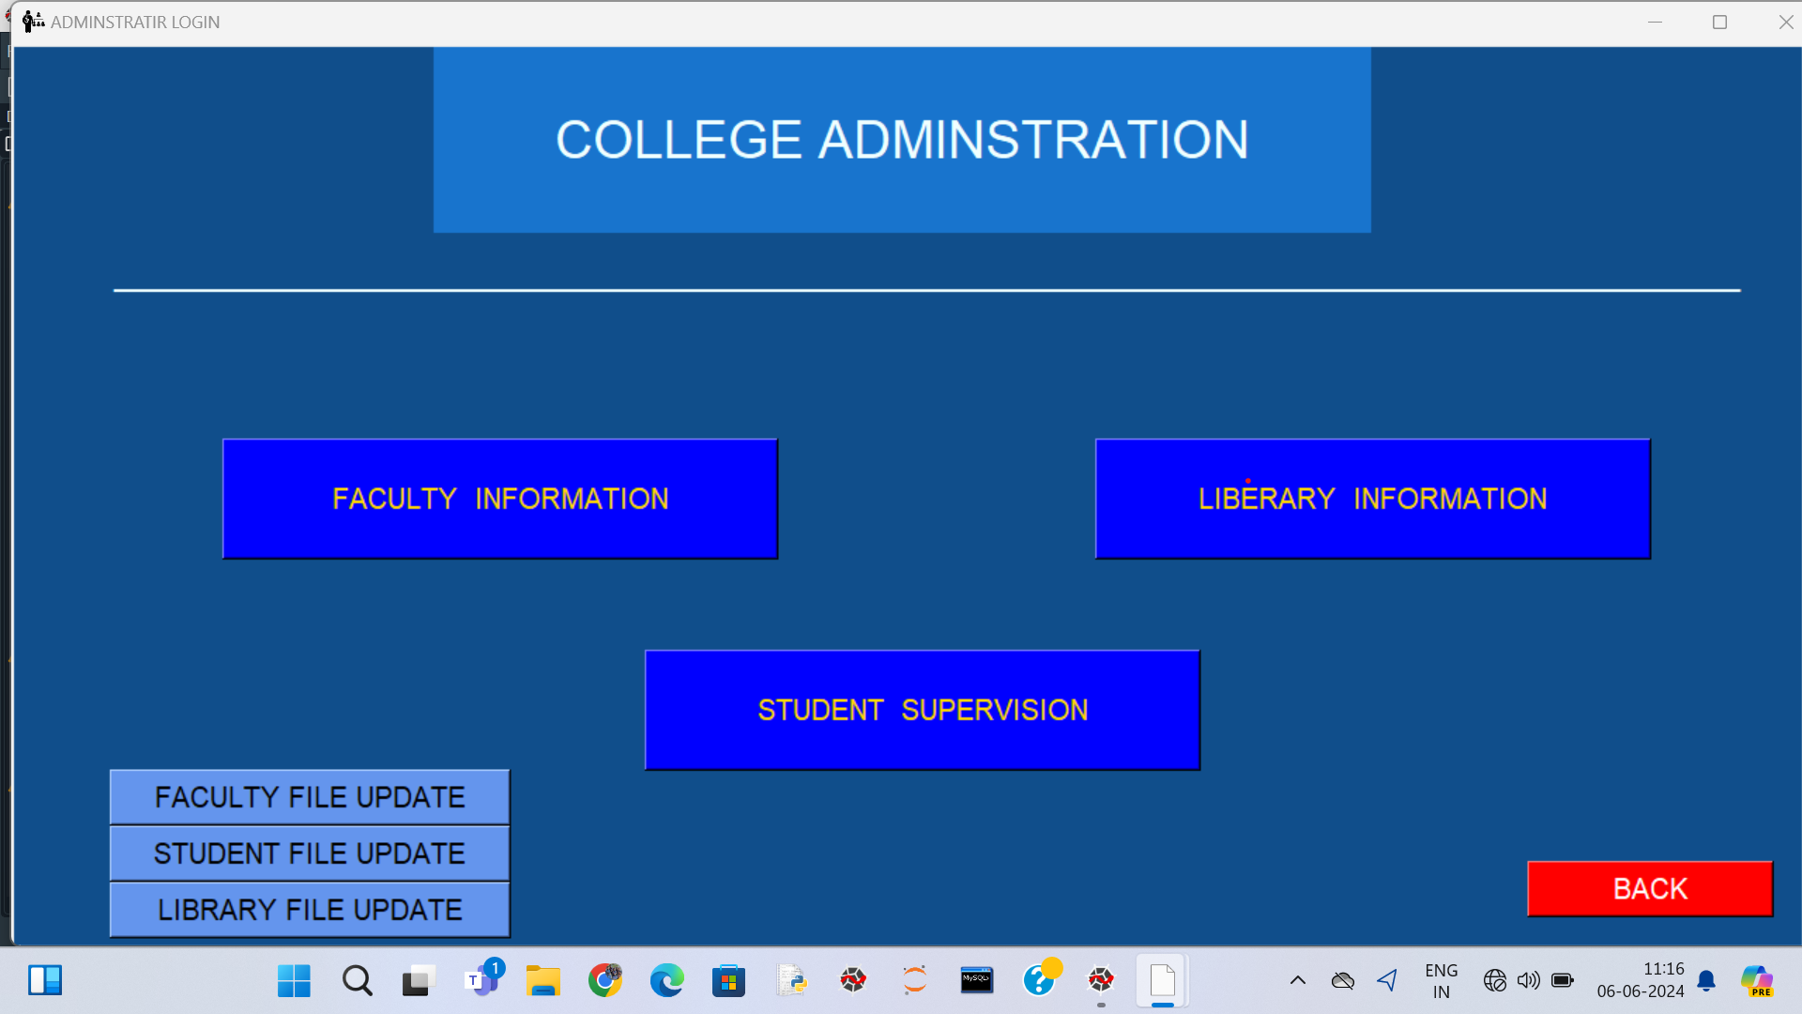

Slide 19
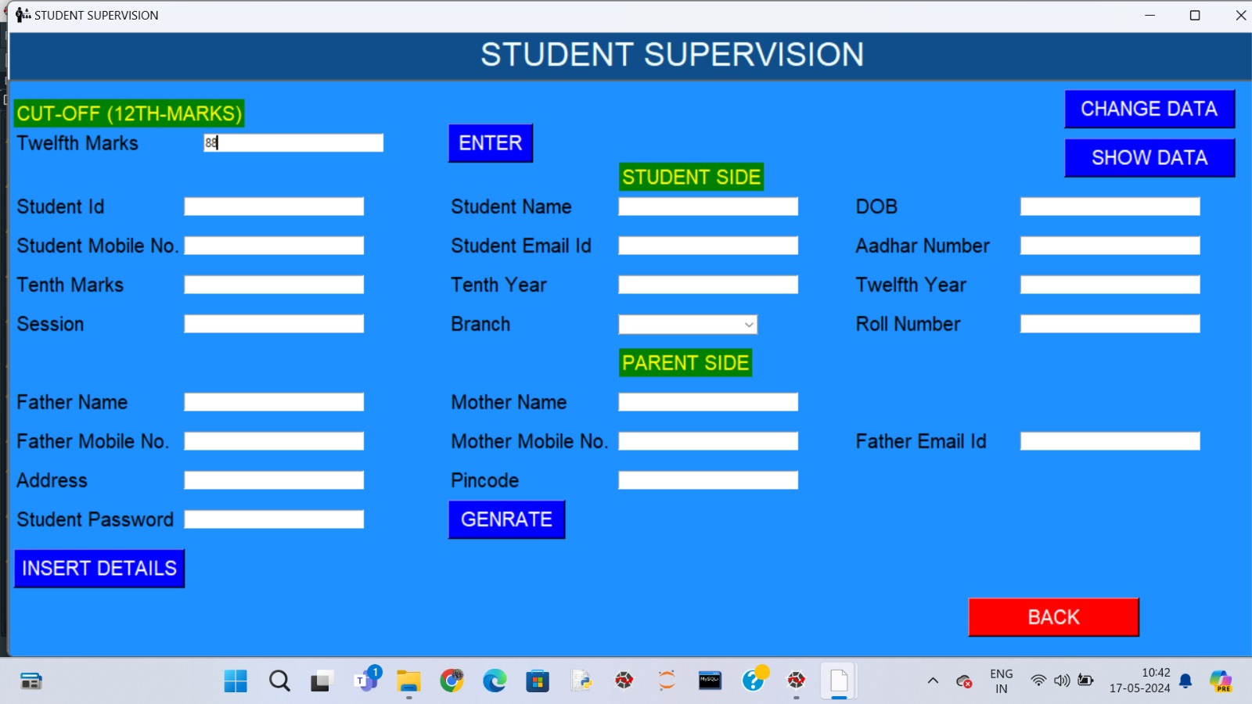
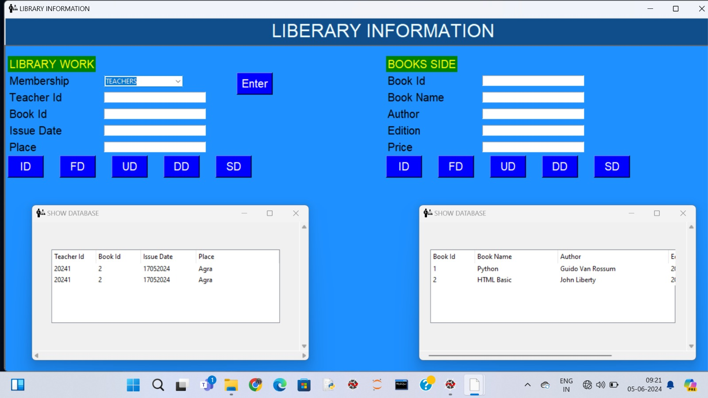
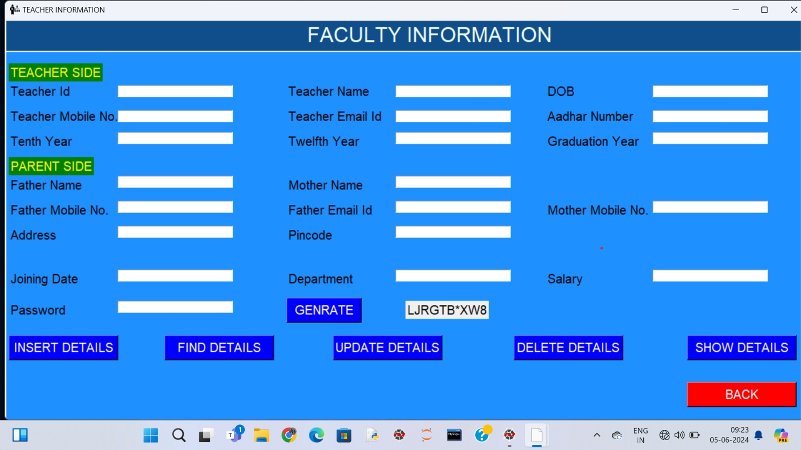

Slide 20
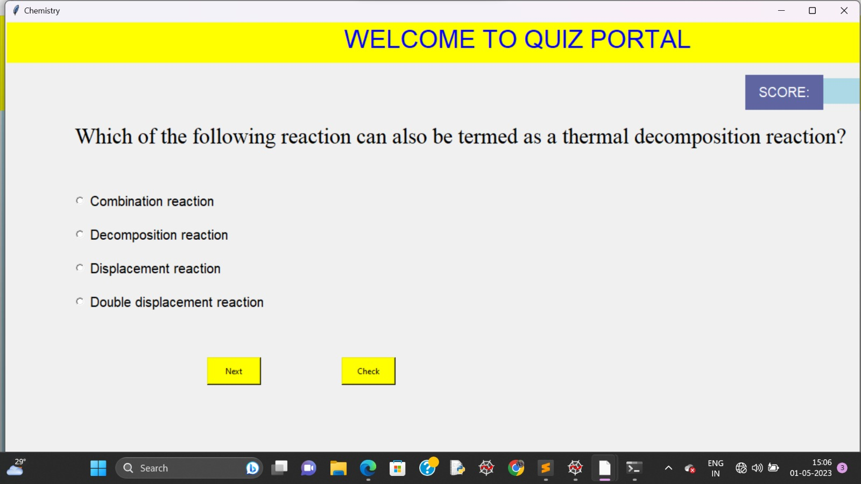
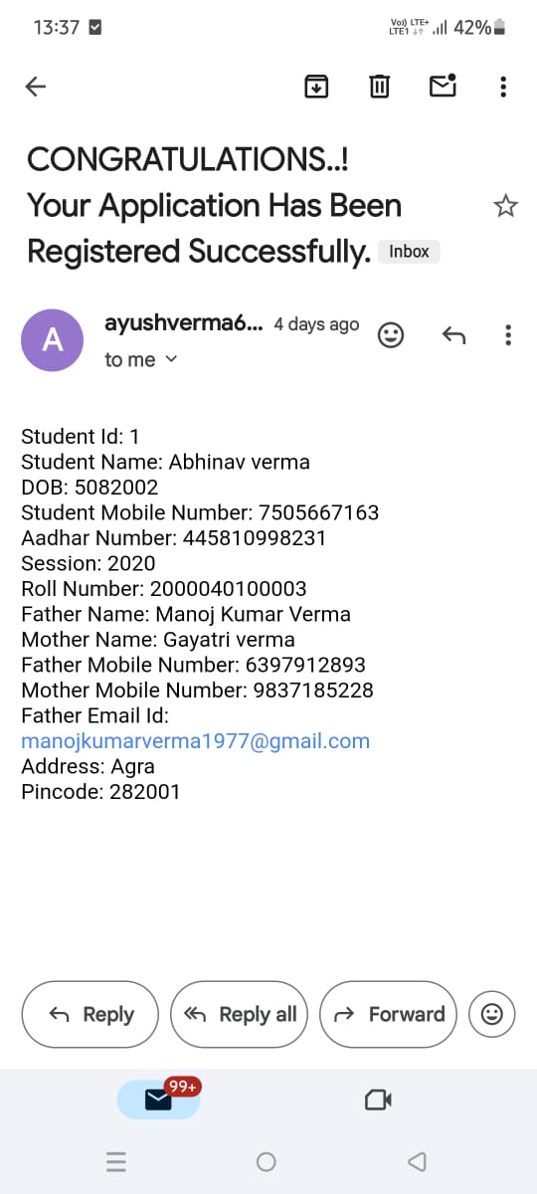

Slide 21
CONCLUSION
Developing a Smart College System Software that addresses these challenges and incorporates advanced features will significantly contribute to the efficiency and effectiveness of educational Institutions, ensuring a seamless experience for students, faculty, and administrative alike.

Slide 22
REFERENCES
Zhi-gang YUE, You-Wei JIN “The development and design of the student management system based on the network environment-20 January 2011”.
Katsaros "A Holistic View of Information Management in Cloud Environments-02 August 2012".
Yang "An Efficient and Secure Dynamic Auditing Protocol for Data Storage in Cloud Computing-24 September 2012".

Slide 23
Thank you
.

